Slide 1
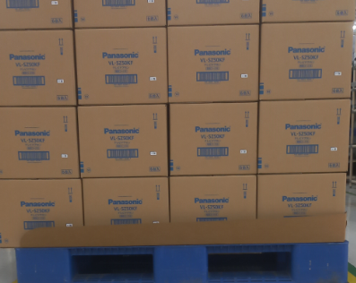

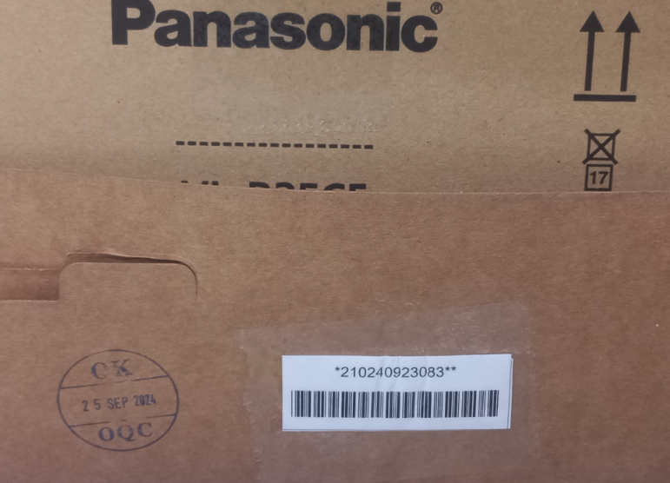
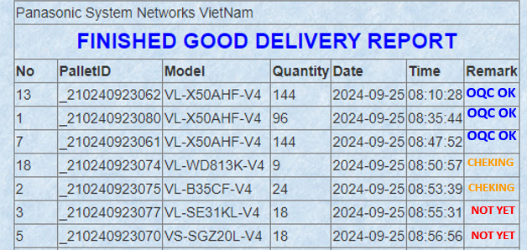
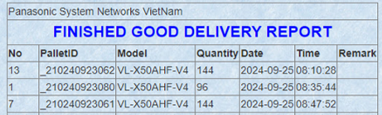
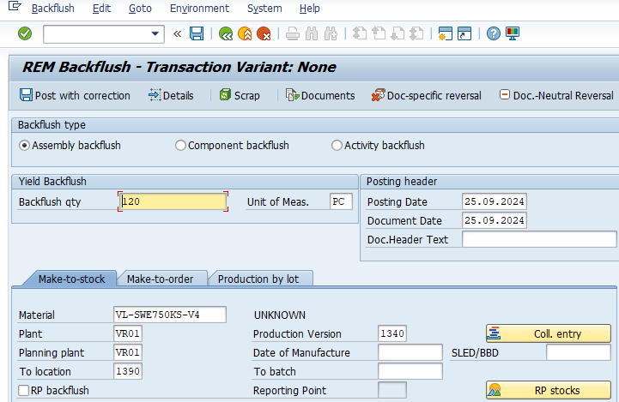
OQC digital system - Change method transfer F/G to SCS
PRODUCTIVITY
Section: DP
PIC: P .T .Huong
Investment: 0K USD
Issue date: Sep.2024
Status: Completed
BEFORE
AFTER
Current process
Improvement process
Production F/G OK
Production F/G OK
FA Make ID ID pallet
FA Make ID ID pallet
Waiting OQC check
Waiting OQC check
OQC stamping OK on slip sheet
OQC stamping OK on System
OQC OK
Manual check OQC OK
OQC OK
Check OQC OK by PDA
OQC OK
Download ID pallet scaned
LINK
Download ID pallet scaned
FA transfer SCS (SAP system)
Auto transfer
SCS (SAP system)
Print movement slip
Print movement slip
SCS Receive the finish goods Scan ID Pallet Code
FA transfer SCS (Actual)
FA transfer SCS (Actual)
Currently
Manual check OQC display OK
Manual transfer F/G to SCS (SAP system)
Printing hard movement slip: 3600pcs/monthly ⬄ 7.2Ream
Cost: 7.2*2.47$ = 17.78$/month ~ 213.4$/Year
Improvement
Check OQC OK by PDA
Auto transfer F/G to SCS (SAP system)
Abolish hard movement slip: 7.2Ream
Save Cost: 213.4$/Year
Reduced : 213.4 S/Y

